Slide 1
Using Business Intelligence to Analyze Diabetes Risk Patterns
Jay Khatri
M.S. Data Analytics, CSU Global
ISM581: Capstone - Business Intelligence and Data Analytics
Dr. Justin Bateh
Module 8: Portfolio Project – Presentation
Notes:
Hello, my name is Jay Khatri, and this presentation summarizes my capstone project for MIS581. My project focuses on using business intelligence and data analytics to examine lifestyle and health related factors associated with diabetes and prediabetes risk. The goal of this project is not to diagnose individual patients, but to identify broad risk patterns that could help healthcare organizations improve prevention planning, outreach, and decision making.

Slide 2
Project Purpose and Business Problem
-Diabetes and prediabetes create major health and cost challenges for healthcare organizations
-Goal: identify lifestyle and health related patterns connected to diabetes/prediabetes risk
-Business intelligence can support prevention planning, outreach, and resource allocation
Notes:
Diabetes and prediabetes are major healthcare concerns because they affect patient outcomes, long term quality of life, and organizational costs. Diabetes occurs when the body cannot properly regulate blood glucose, either because it does not produce enough insulin or cannot use insulin effectively. Over time, uncontrolled diabetes can contribute to complications such as heart disease, kidney disease, vision loss, and other serious health problems.
From a business intelligence perspective, this makes diabetes an important area for prevention planning. If healthcare organizations can identify broad risk patterns earlier, they may be able to improve screening reminders, patient outreach, education, and resource allocation. This project focuses on using the CDC Diabetes Health Indicators dataset to examine lifestyle and health related variables connected to diabetes and prediabetes risk.
Sources: CDC, 2025; Parker et al., 2024

Slide 3
Dataset Overview
-Dataset: CDC Diabetes Health Indicators
-253,680 records and 22 variables
-Target variable: Diabetes_binary
-Key variables: BMI, high blood pressure, high cholesterol, physical activity, smoking, general health
Notes:
For this project, I used the CDC Diabetes Health Indicators dataset from the UCI Machine Learning Repository. The dataset includes 253,680 records and 22 variables. The main target variable is Diabetes_binary, where 0 represents individuals without diabetes and 1 represents individuals with diabetes or prediabetes. I focused on variables that were most connected to my research questions, including BMI, high blood pressure, high cholesterol, physical activity, smoking, and general health. This dataset was a good fit because it includes both health related and lifestyle related indicators, which allowed me to examine diabetes and prediabetes risk patterns from multiple angles.
Source: UCI Machine Learning Repository, 2023

Slide 4
Research Questions and Hypotheses
-Are BMI, high blood pressure, and high cholesterol associated with diabetes/prediabetes status?
-Is physical activity associated with diabetes/prediabetes status?
-Can selected health and lifestyle variables help classify diabetes/prediabetes risk?
-Null hypotheses tested whether no significant differences or associations existed
Notes:
The main research question for this project was to identify which lifestyle and health related factors are associated with diabetes or prediabetes status. I focused on BMI, high blood pressure, high cholesterol, physical activity, smoking, and general health. For the hypotheses, the null hypothesis generally stated that there was no significant difference or association between each factor and diabetes or prediabetes status. The alternative hypotheses stated that these factors were significantly associated with diabetes or prediabetes status. I also tested whether a model using these selected variables could help classify diabetes or prediabetes risk.

Slide 5
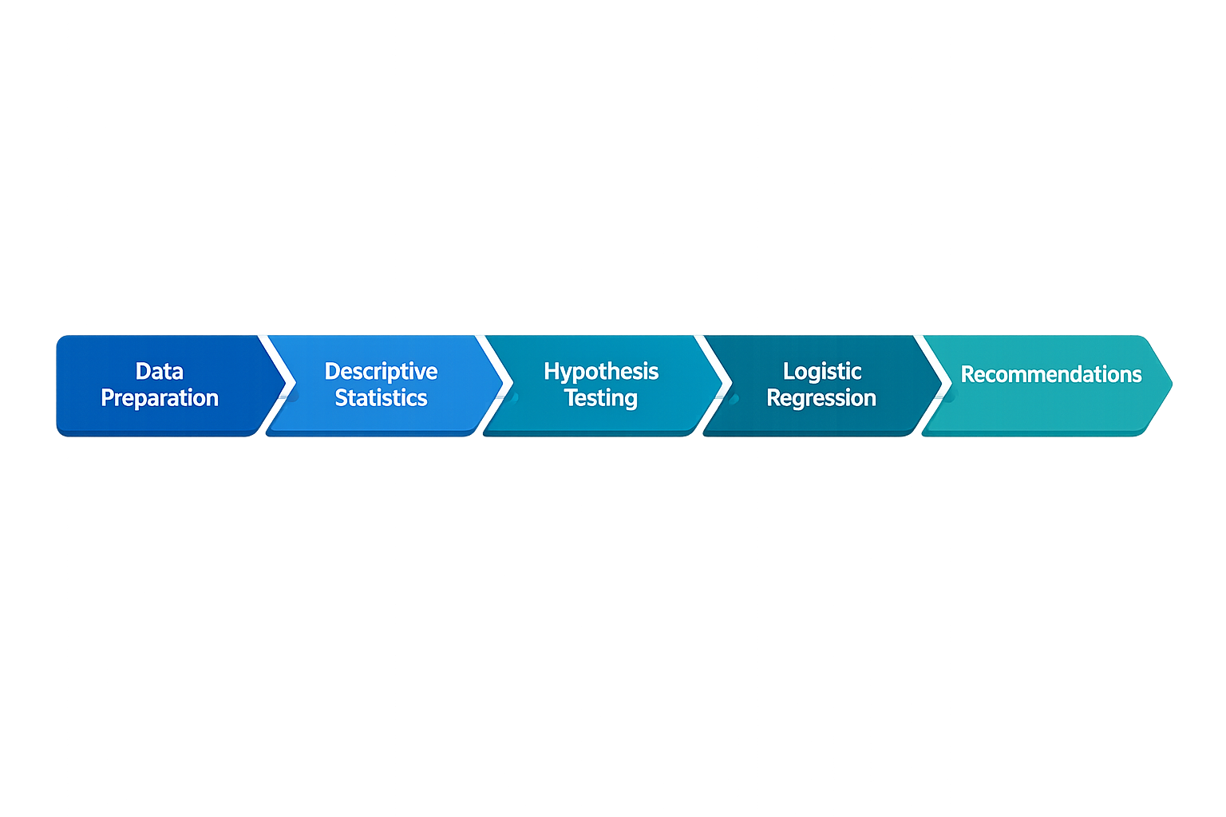
Methods and Tools
-Tools: Python, Jupyter Notebook, pandas, matplotlib, scikit-learn
-Descriptive statistics compared diabetes/prediabetes vs. no-diabetes groups
-Welch’s t-test tested BMI differences
-Chi-square tests tested categorical variables
-Logistic regression evaluated classification ability
Notes:
For this project, I followed a step by step analysis process. I first prepared the data in Python using Jupyter Notebook and pandas. This included loading the dataset, reviewing the number of records and variables, checking for missing values, and making sure the coded variables were understood correctly.
After preparing the data, I used descriptive statistics to compare the no-diabetes group with the diabetes/prediabetes group. Then, I used hypothesis testing to determine whether the differences between groups were statistically meaningful. Welch’s t-test was used for BMI, while chi-square tests were used for categorical variables like high blood pressure, high cholesterol, physical activity, and smoking.
Finally, I used logistic regression to evaluate whether selected lifestyle and health related variables could help classify diabetes or prediabetes status. The results from these steps were then used to develop recommendations for healthcare dashboards, patient outreach, and prevention planning.

Slide 6
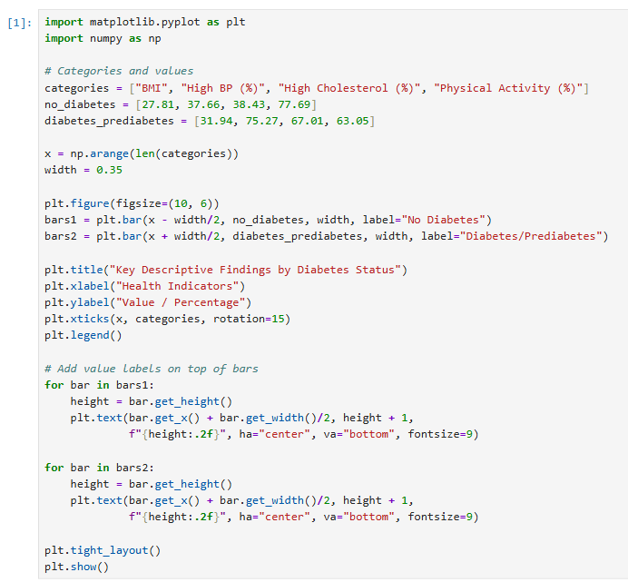
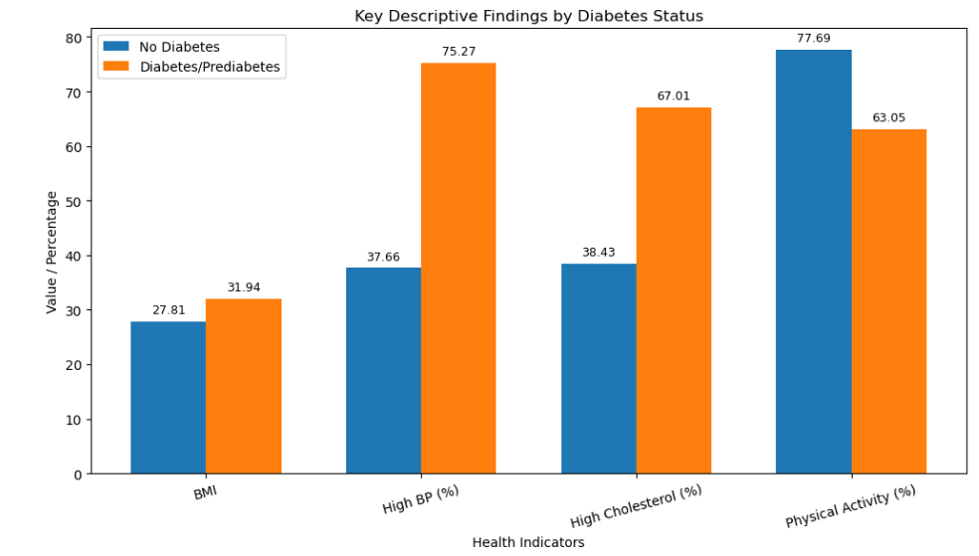
Key Descriptive Findings
Higher average BMI: 31.94 vs. 27.81
Higher high blood pressure rate: 75.27% vs. 37.66%
Higher high cholesterol rate: 67.01% vs. 38.43%
Lower physical activity rate: 63.05% vs. 77.69%
Notes:
This slide shows the main descriptive findings from the dataset. The blue bars represent individuals without diabetes, and the orange bars represent individuals with diabetes or prediabetes. The diabetes/prediabetes group had a higher average BMI, at 31.94 compared to 27.81. They also had much higher rates of high blood pressure and high cholesterol. High blood pressure was 75.27% in the diabetes/prediabetes group compared to 37.66% in the no-diabetes group, and high cholesterol was 67.01% compared to 38.43%.
Physical activity showed the opposite pattern. The no-diabetes group had a higher physical activity rate at 77.69%, while the diabetes/prediabetes group was lower at 63.05%. Overall, this chart shows that diabetes and prediabetes risk is connected to multiple health and lifestyle factors, not just one single variable.

Slide 7
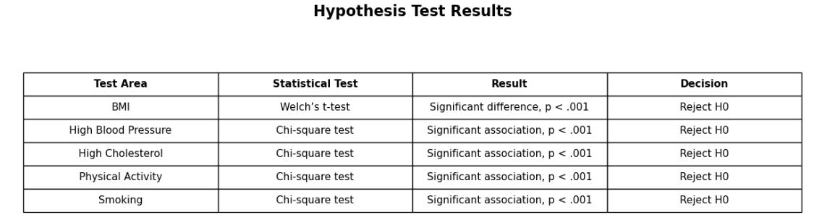
Hypothesis Test Results
Takeaway: The null hypotheses were rejected for the main health and lifestyle indicators.
These results match the findings section where BMI, high blood pressure, high cholesterol, physical activity, and smoking were all statistically significant.
Notes:
This slide summarizes the hypothesis test results. For BMI, I used Welch’s t-test because BMI is a numeric variable. For high blood pressure, high cholesterol, physical activity, and smoking, I used chi-square tests because those variables are categorical.
All of the results had p-values less than .001. A p-value less than .001 means the results were statistically significant and very unlikely to be due to random chance. In simple terms, there is less than a 0.1% probability of seeing results this strong if the null hypothesis were actually true.
Because of this, I rejected the null hypotheses for BMI, high blood pressure, high cholesterol, physical activity, and smoking. This supports the idea that these lifestyle and health related indicators are meaningfully associated with diabetes or prediabetes status in the dataset.

Slide 8
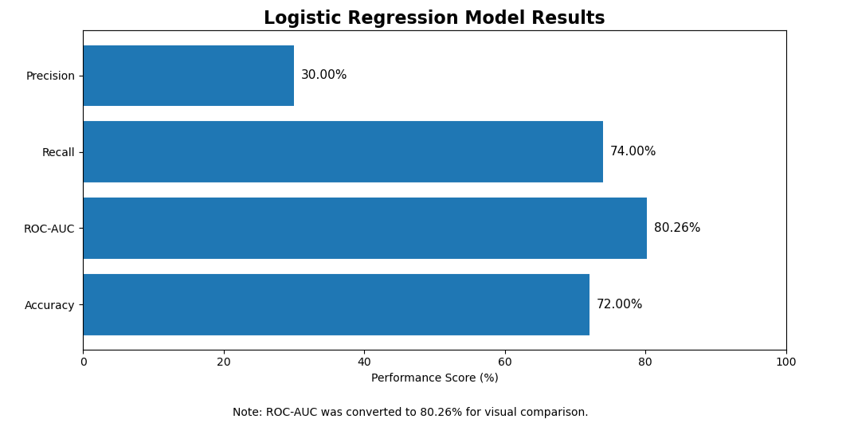
Logistic Regression Model Results
-Model used BMI, high BP, high cholesterol, physical activity, smoking, and general health
-Overall accuracy: 72%
-ROC-AUC: 0.8026
-Recall for diabetes/prediabetes group: 0.74
-Precision for diabetes/prediabetes group: 0.30
Notes:
This slide shows the logistic regression model results. The model had an accuracy of 72%, meaning it correctly classified many cases overall. The ROC-AUC (R-O-C A-U-C) score, was 0.8026, or about 80.26%. ROC-AUC measures how well the model separates the two groups, so this result suggests the model had reasonable ability to distinguish between diabetes/prediabetes cases and no-diabetes cases.
The recall for the diabetes/prediabetes group was 74%, meaning the model identified many actual diabetes or prediabetes cases. This could be useful for screening support and prevention planning because healthcare organizations may want to identify people who may need follow-up. However, precision was only 30%, which means many people flagged by the model may not actually have diabetes or prediabetes. Because of this, the model should not be used as a diagnosis tool. It is better used as a business intelligence support tool for outreach, screening reminders, and prevention planning.

Slide 9
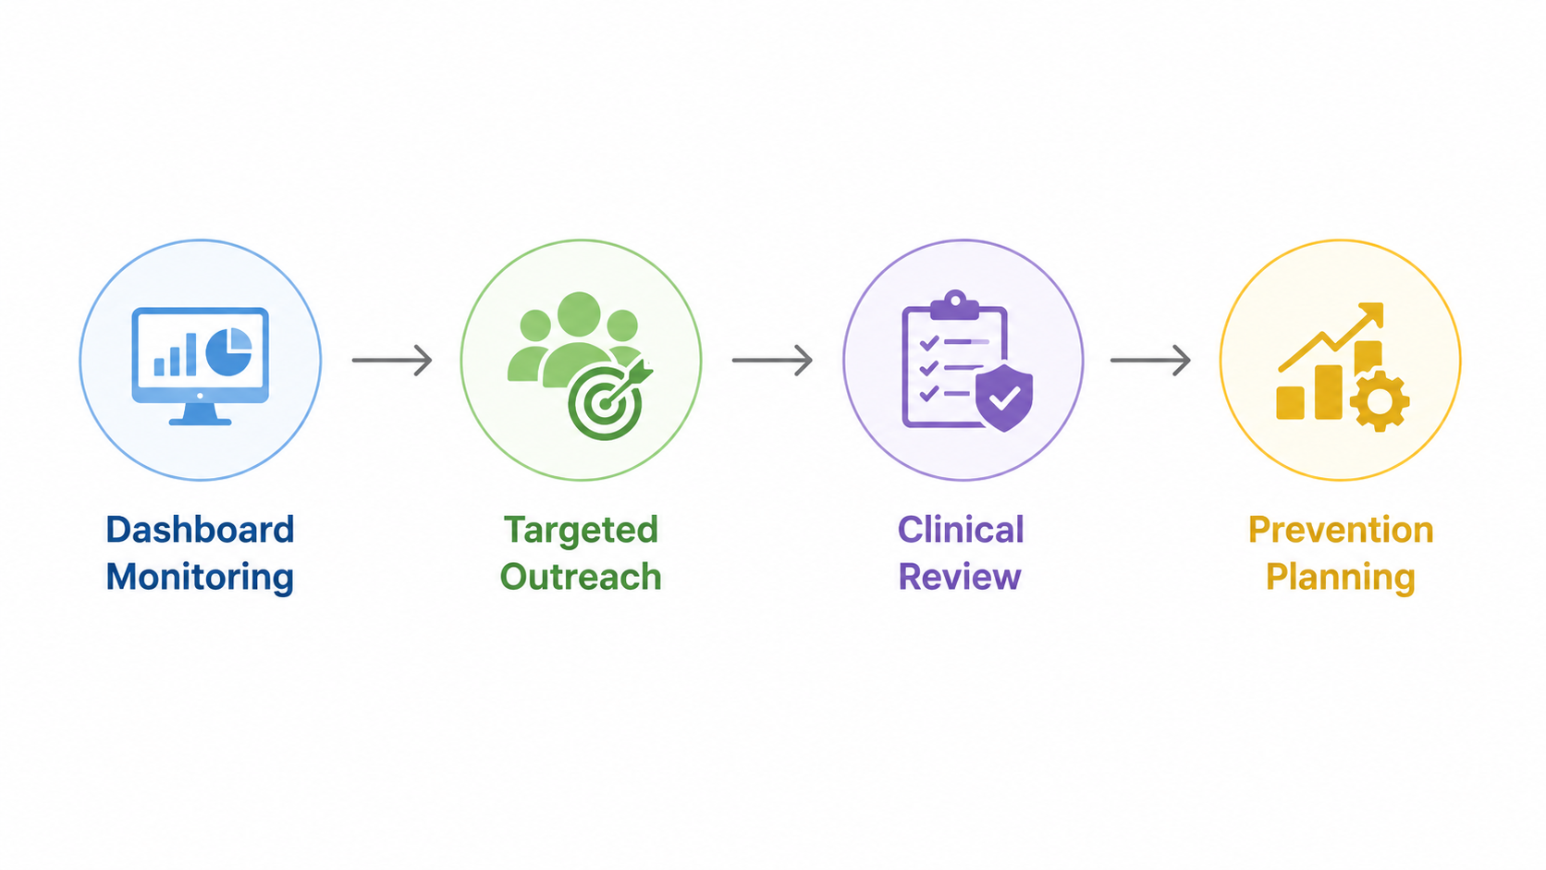
Organizational Application and Recommendations
-Use BI dashboards to monitor diabetes-related risk patterns
-Target outreach to groups with high BP, high cholesterol, higher BMI, and low physical activity
-Use the model for screening support, not diagnosis
-Improve future data with lab results, family history, medication use, and detailed lifestyle data
Notes:
This slide focuses on how the findings could be used in a healthcare organization. One practical recommendation is to use business intelligence dashboards to monitor diabetes related risk patterns across patient populations. For example, an organization could track groups with higher BMI, high blood pressure, high cholesterol, and lower physical activity.
These insights could support targeted outreach, such as screening reminders, primary care follow ups, wellness resources, and patient education. The logistic regression model could also help identify groups that may need additional attention, but it should not be used as a diagnostic tool. Since the model had low precision, clinical staff should review results before any patient care decisions are made.
For future improvement, organizations should collect more detailed data, such as lab results, family history, medication use, diet, and exact physical activity levels. Adding those variables could make future models more accurate and more useful for prevention planning.

Slide 10
References
Aune, D., Norat, T., Leitzmann, M., Tonstad, S., & Vatten, L. J. (2015). Physical activity and the risk of type 2 diabetes: A systematic review and dose-response meta-analysis. European Journal of Epidemiology, 30(7), 529–542. https://doi.org/10.1007/s10654-015-0056-z
Centers for Disease Control and Prevention. (2025). Behavioral Risk Factor Surveillance System. https://www.cdc.gov/brfss/index.html
Parker, E. D., Lin, J., Mahoney, T., Ume, N., Yang, G., Gabbay, R. A., ElSayed, N. A., & Bannuru, R. R. (2024). Economic costs of diabetes in the U.S. in 2022. Diabetes Care, 47(1), 26–43. https://doi.org/10.2337/dci23-0085
Prats-Uribe, A., Paredes, R., Prieto-Alhambra, D., & Raventós, B. (2024). Identifying top ten predictors of type 2 diabetes through machine learning analysis of UK Biobank data. Scientific Reports, 14, Article 2102. https://doi.org/10.1038/s41598-024-52023-5
University of California Irvine Machine Learning Repository. (2023). CDC diabetes health indicators. https://archive.ics.uci.edu/dataset/891/cdc+diabetes+health+indicators
U.S. Department of Health and Human Services. (2024). The HIPAA Privacy Rule. https://www.hhs.gov/hipaa/for-professionals/privacy/index.html
Notes:
This slide lists the main sources used to support the project. The CDC and UCI sources supported the dataset background, while the scholarly articles helped connect the project findings to existing diabetes research. The HHS source was used to support the privacy and ethical considerations related to health data. Overall, these sources helped guide the project from the research background to the analysis and final recommendations.
Thank you, I appreciate everyone taking the time to listen and enjoy this presentation. Special thanks to Dr. Justin B. for being a great professor and giving valuable guidance.

